Slide 1

MVE441 Project 3 Clusters and Classes Theme 1
By
Filip Nyman Nils Hammar Rebecka Lennartsson Natanael Lennartsson

Slide 2
Clusterers and Separators
PCA OR RBF-Kernel PCA
K means
DBScan
Birch
Elbow
Silhuette

Slide 3
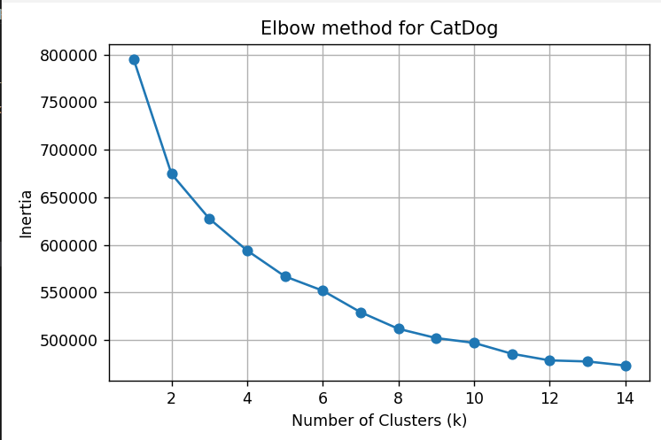
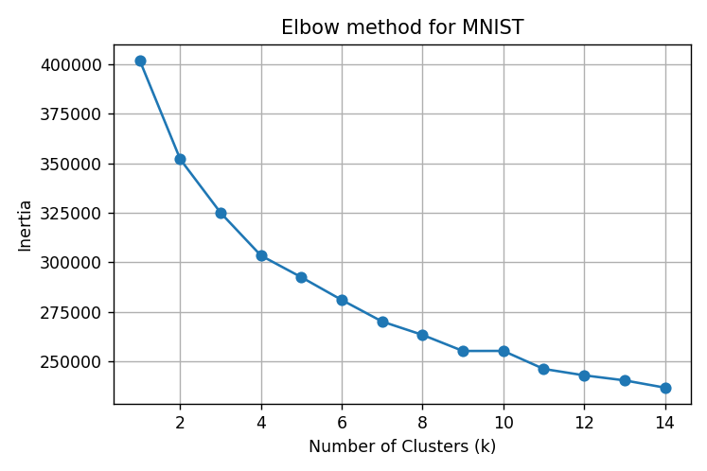
ELbow

Slide 4
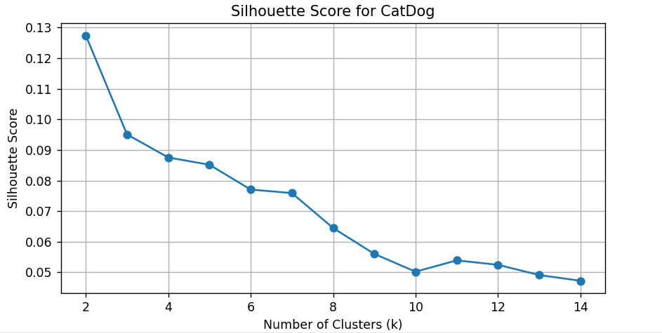
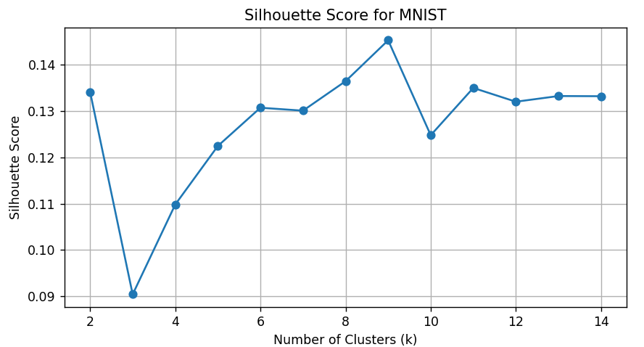
Silhouette

Slide 5
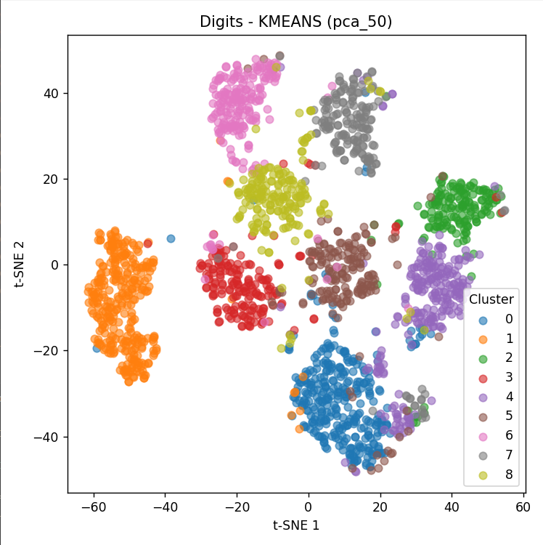
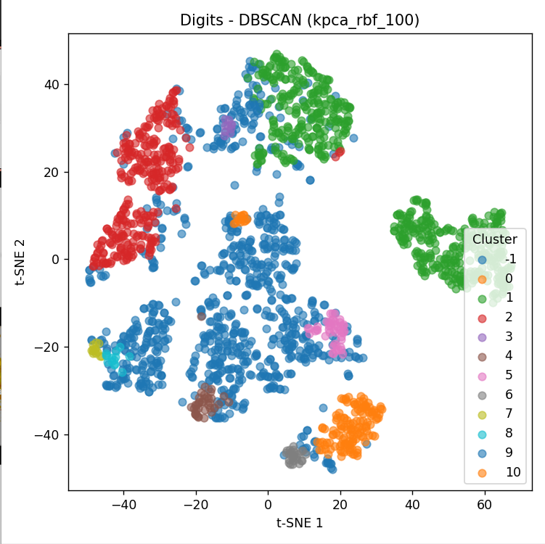
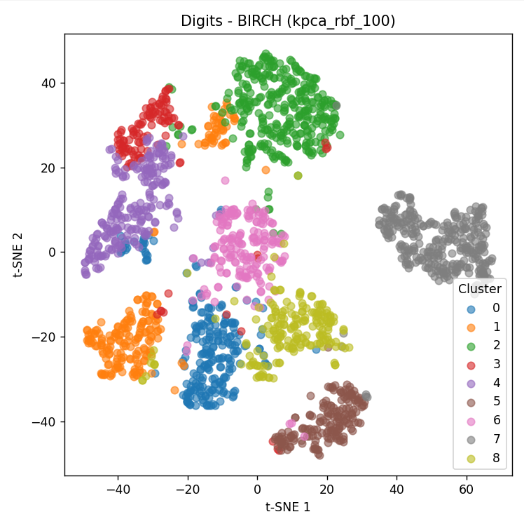
Feature: pca_50
Params: kmeans_9_20
Accuracy: 0.708
ARI: 0.607
Feature: kpca_rbf_100
Params: dbscan_0.5_10
Accuracy: 0.503
ARI: 0.326
Feature: kpca_rbf_100
Params: birch_0.5_20
Accuracy: 0.760
ARI: 0.678

Slide 6
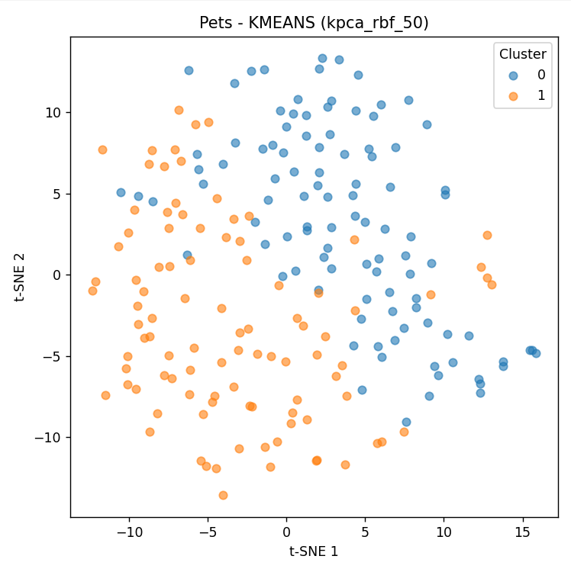
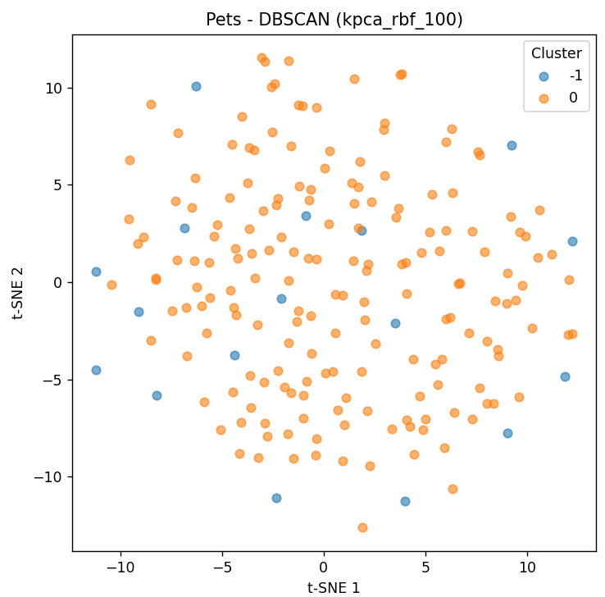
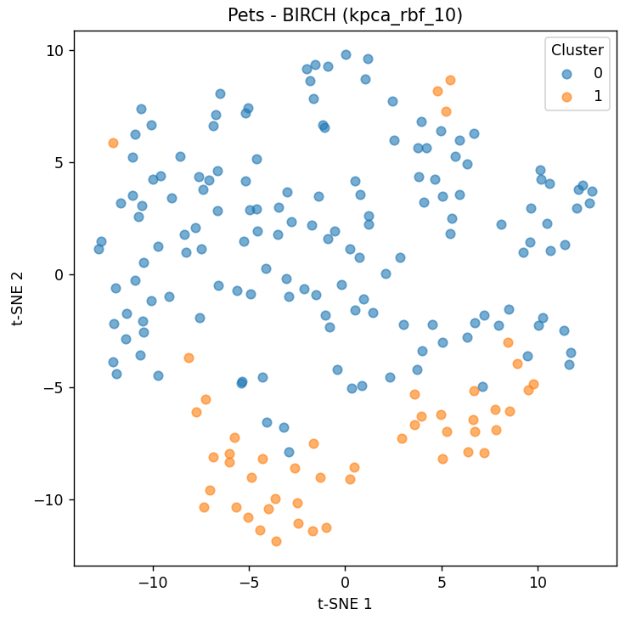
Feature: kpca_rbf_50
Params: kmeans_2_10
Accuracy: 0.576
ARI: 0.018
Feature: kpca_rbf_100
Params: dbscan_1.0_3
Accuracy: 0.566
ARI: 0.016
Feature: kpca_rbf_10
Params: birch_0.3_20
Accuracy: 0.717
ARI: 0.186

Slide 7
Part 2 Sample Size Imbalance

Slide 8
Sample size

Slide 9
Imbalance

Slide 10
Conclusion

Slide 11
Questions?

